Slide 1

AUTOMATED HEART RATE MONITOR
TEAM MEMEBERS :
Naveen M (20181CSE0476)
NAVEEN MH (20181CSE0477)
NAVEEN R (20181CSE0478)
NIKITHA AS (20181CSE0487)
NISHITHAA PALANI (20181CSE0490)
NITHIN REDDY (20181CSE0493)
-UNDER THE GUIDANCE OF AFROZ PASHA AND PRAKASH B METRE

Slide 2
ABSTRACT
The Heart Rate Monitoring system is developed using IOT technology with an objective of detecting the heart beat of the patient in order to monitor the risk of heart attack and also the regular checkup. Body health monitoring is very important to us to make sure our health is in excellent condition. One of the vital parameter for this device under consideration is the heart rate (HR).
In this project we describe the design of low cost heart rate monitoring device from fingertips . The entire system is comprised of several parts such as Heart Rate module, Android application .
The Heart Rate (HR) module picks up heart rate signal by a non-invasive technique from the subject (patients) and sends it (signal) wirelessly to computer or android application .
This system can be embraced and combined as a part of telemedicine constituent. The data received from heart rate module can be saved and viewed for further medical usage. The result from this device prototype can be utilized for various clinical investigations.

Slide 3
INTRODUCTION
The heart is one of the most important organs in the human body. It acts as a pump for circulating oxygen and blood throughout the body, thus keeping the functionality of the body intact. A heartbeat can be defined as a two-part pumping action of the heart which occurs for almost a second. It is produced due to the contraction of the heart.
Heart diseases are one of the most important causes of death among men and women. It claims approximately 1 million deaths every year. Heart rate is a critical parameter in the functioning of the heart.
Therefore heart rate monitoring is crucial in the study of heart performance and thereby maintaining heart health.
This paper proposes a heart rate monitoring detection system using IoT.
Nowadays treatment of most of the heart-related diseases requires continuous as well as long term monitoring. IoT is very useful in this aspect as it replaces the conventional monitoring systems with a more efficient scheme, by providing critical information regarding the condition of the patient accessible by the doctor. In addition, the nurses or the duty doctor available at the hospital can monitor the heart rate of the patient in the serial monitor through the real-time monitoring system.

Slide 4
REQUIREMENTS / COMPONETS NEEDED
1)Arduino Uno
2) Pulse Oximeter
3) LED display screen
4) Jumper wires
5) Bread board

Slide 5
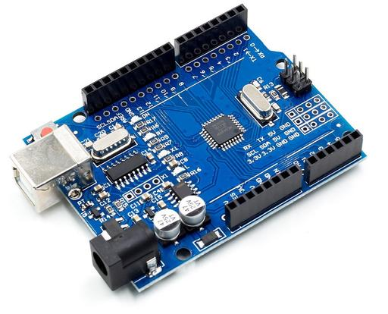
ADRUINO UNO
ADRUINO UNO: Arduino UNO is micro-controller , having 14 digital In/Out pins.
It is an open-source microcontroller development board based on the ATmega328P(datasheet) which has:14 digital input/output pins6 analog inputs A 16 MHz quartz crystal, A USB connection, A power jack, An ICSP header Anda reset button

Slide 6
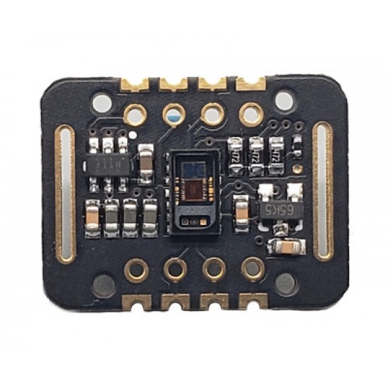
PULSE Oximeter Max30102
PULSE SENSOR: The MAX30102 is an integrated pulse oximetry and heart-rate monitor module. It includes internal LEDs,
photodetectors, optical elements, and low-noise electronics with ambient light rejection.
The MAX30102 operates on a single 1.8V power supply and a separate 3.3V power supply for the internal LEDs.
Communication is through a standard I2C-compatibleinterface.

Slide 7
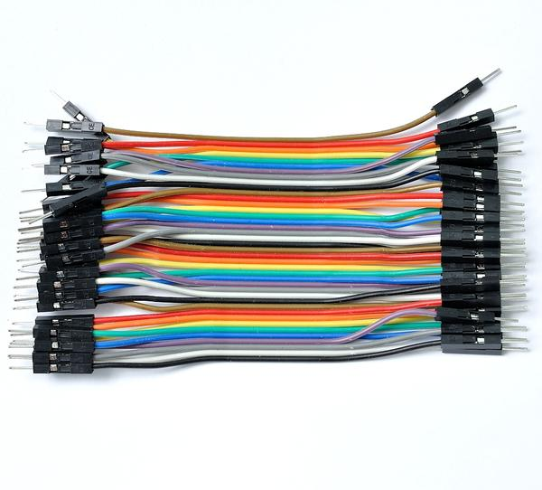
JUMPER WIRES
JUMPER WIRES: Jumper wires are simply wires that have connector pins at each end, allowing them to be used to connect two points to each other without soldering. Jumper wires are typically used with breadboards and other prototyping tools in order to make it easy to change a circuit as needed.

Slide 8
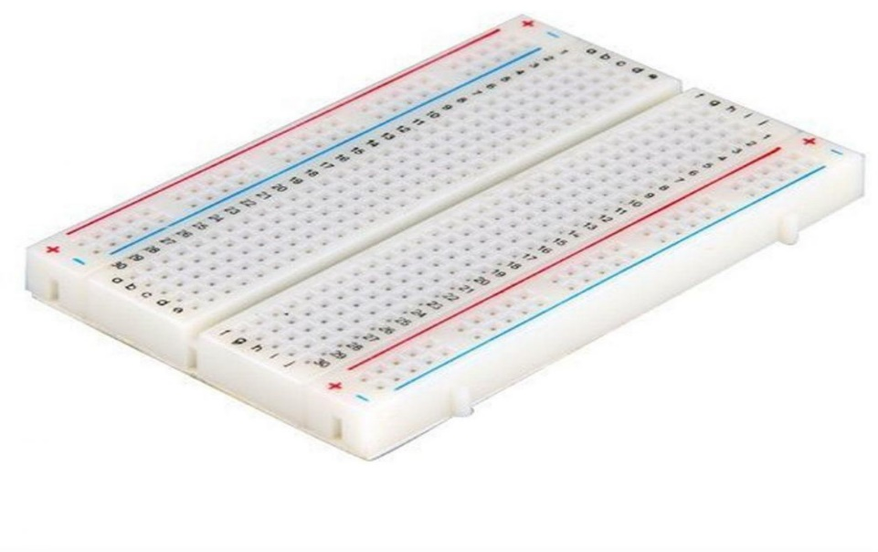
BREAD BOARD
BREAD BOARD: A breadboard is a solder less device for temporary prototype with electronics and test circuit designs. The breadboard has strips of the metal underneath the board and connect the holes on the top of the board.

Slide 9
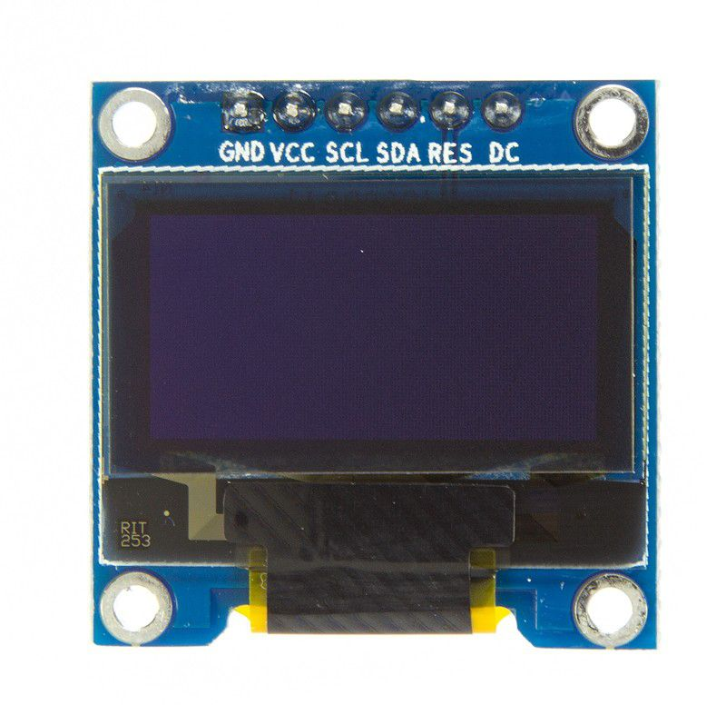
LCD DISPLAY SCREEN
LED display screen : LED (Organic Light Emitting Diode)
OLED I2C Display .The display connects to Arduino using only four wires – two for power and two for data, making the wiring very simple.
The data connection is I2C (I²C, IIC or Inter-Integrated Circuit).
This interface is sometimes called TWI (Two Wire Interface).

Slide 10
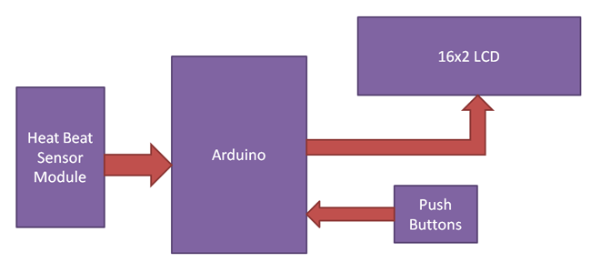
Design
The library files or Modules used are :
Arduino MAX3010x
Adafruit GFX Library
Adafruit_SSD1306
heartrate

Slide 11
Technology
The proposed system is based on the working of infrared light is passing to the blood value and analysis the heart rate. In this ,device is placed on the human fingertip and measure the heart rate through heart beat sensor and send the signal to the controller and GSM and display the accurate value on OLED or LCD platform.

Slide 12
ADVANTAGES AND DISADVANTAGES
ADVANTAGES | DISADVANTAGES
It is inexpensive comparatively | Memory limitations
Cross-platform | less resistance to water
Simple clear programming environment | Processing power is weaker than the microcontroller
Open source and extensible software and hardware | Requires effort to accomplish some tasks such as scheduling and database storage
Its portable and easy to carry around

Slide 13
CONCULSION
An IoT-based human heartbeat rate monitoring and control system is developed. This system uses the capability of a heart pulse sensor for data acquisition. A human’s heartbeat is captured as data signals and processed by the microcontroller. The processed data are transmitted to the IoT platform for further analytics and visualization.
Experimental results obtained were found to be accurate as the system was able to sense and read the heartbeat rate of its user . From the results obtained, it was found that the heartbeat rate of low if >40 and 60 and 100, high if >100 and <150. The implemented device can be deployed to the medical field to assist the medical practitioners to efficiently and reliably do their work without difficulties.

Slide 14
Resources
https://www.researchgate.net/publication/317117507_Heartbeat_and_Temperature_Monitoring_System_for_Remote_Patients_using_Arduino
https://github.com/oxullo/Arduino-MAX30100
Other IOT based reference Web-Sites

